Slide 1
Insurance Price Quote Analysis
Vijaywargiy, Krishna
Sahadevan, Padmanaban

Slide 2
Action Sequence
Data extraction
Data resides in a windows application
Automate data extraction by user action simulation
Consolidate data from multiple applications
Data Management
Normalize data- bring it to tabular form
ETL into database
Insights
Find attributes which influence premium the post
Econometric analysis

Slide 3
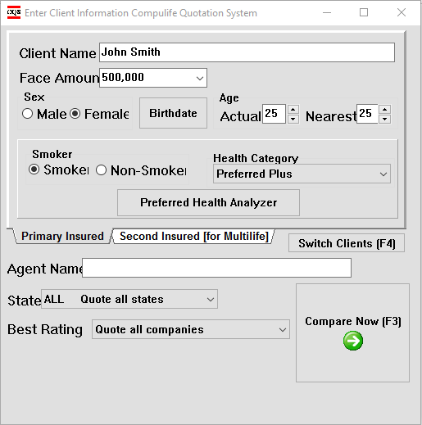
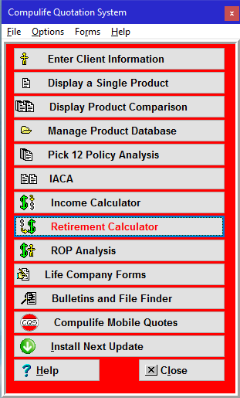
The Application

Slide 4
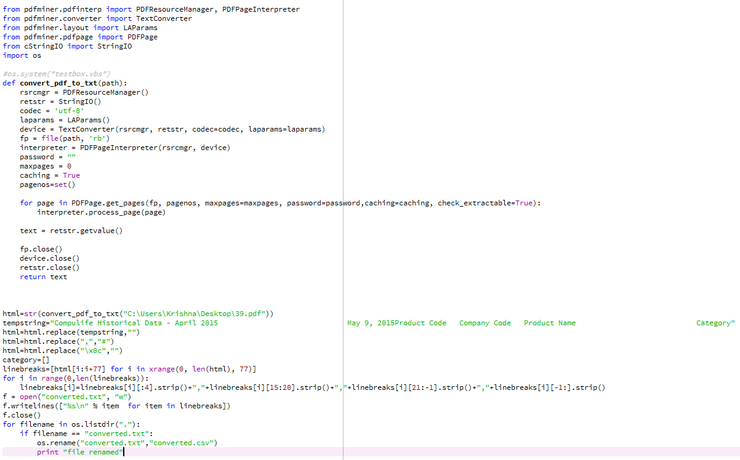
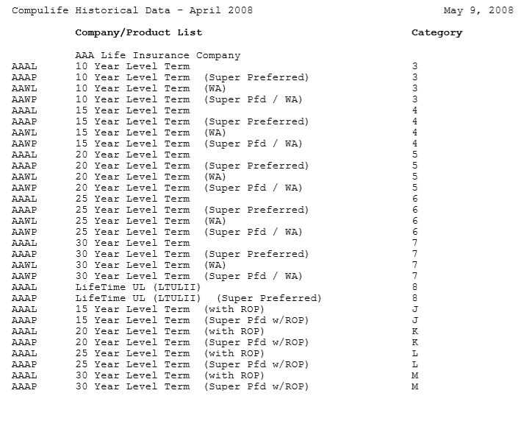
Convert PDF
Code for parsing the PDF and converting into CSV
PDF ScreenShot

Slide 5
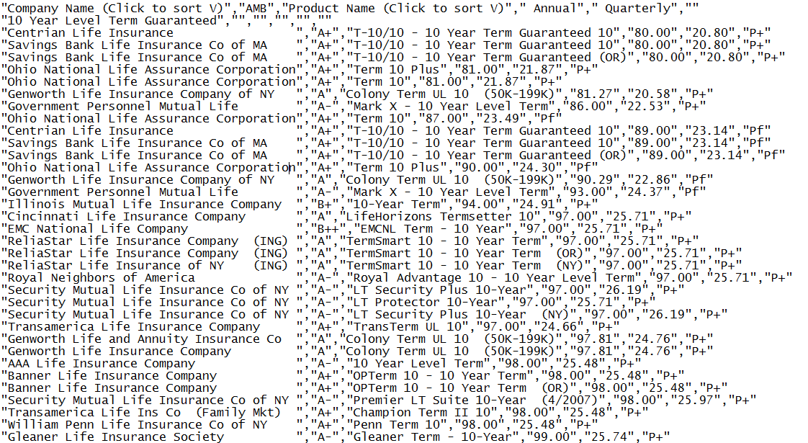
ScreenShot of the converted CSV file

Slide 6
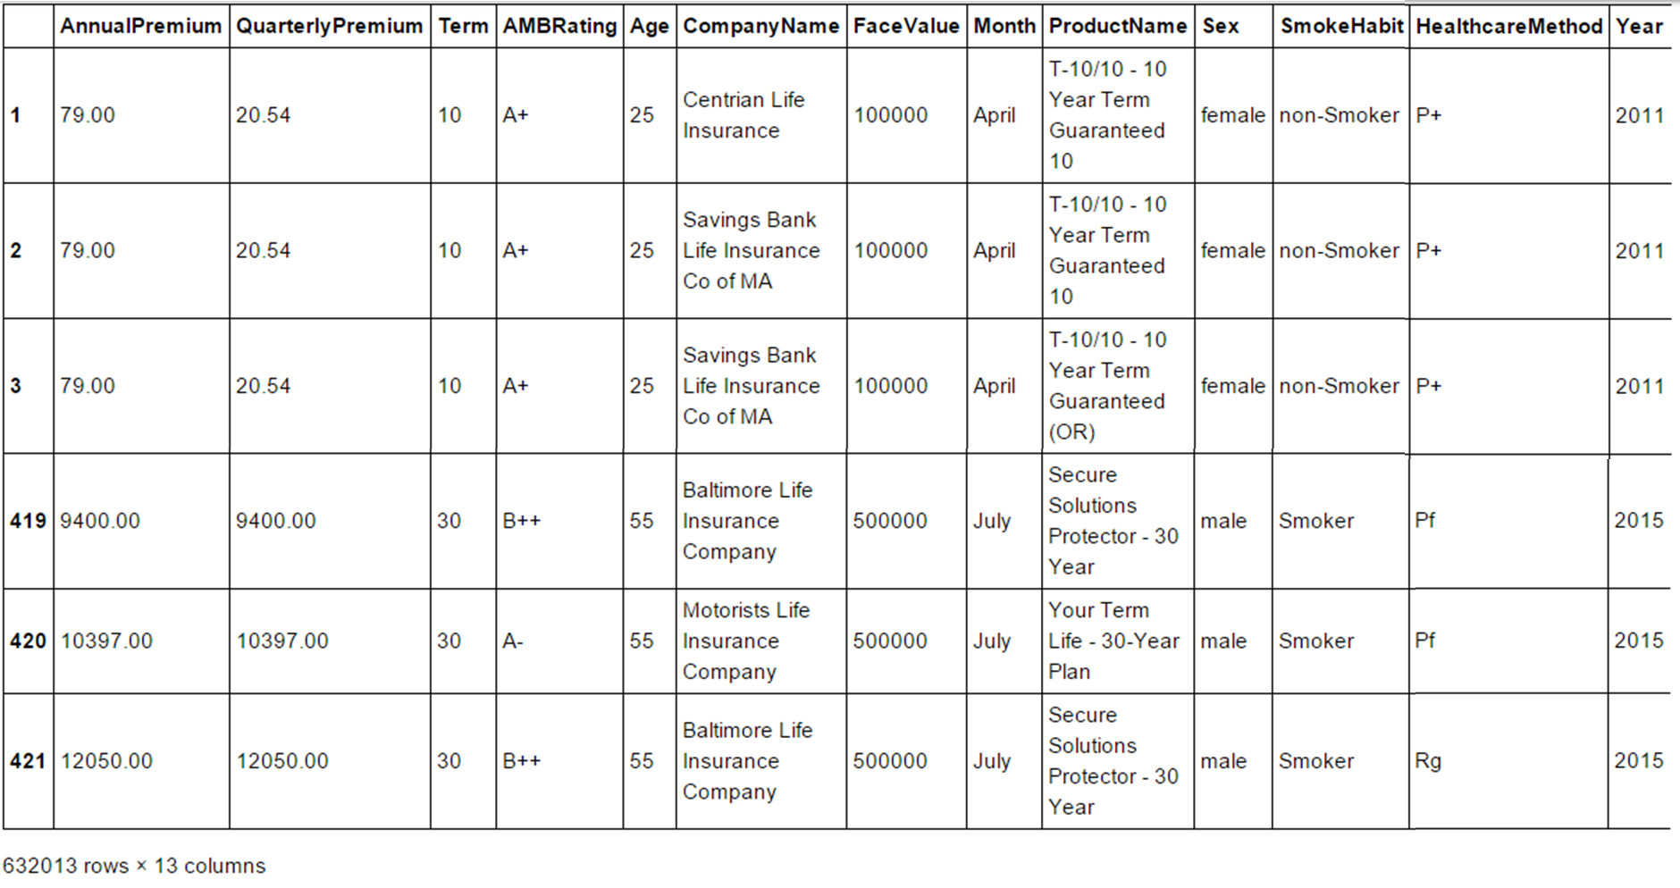
ScreenShot: Pandas DataFrame

Slide 7
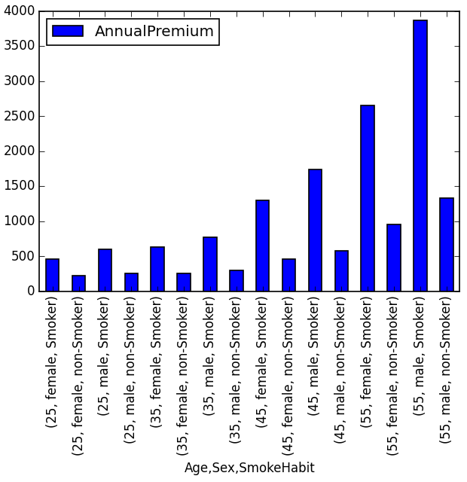
Average Annual Premiums
Based on Age, Sex & Smoke Habit
Parameters:
Face Value
Age
Sex
Term
Years
Months

Slide 8
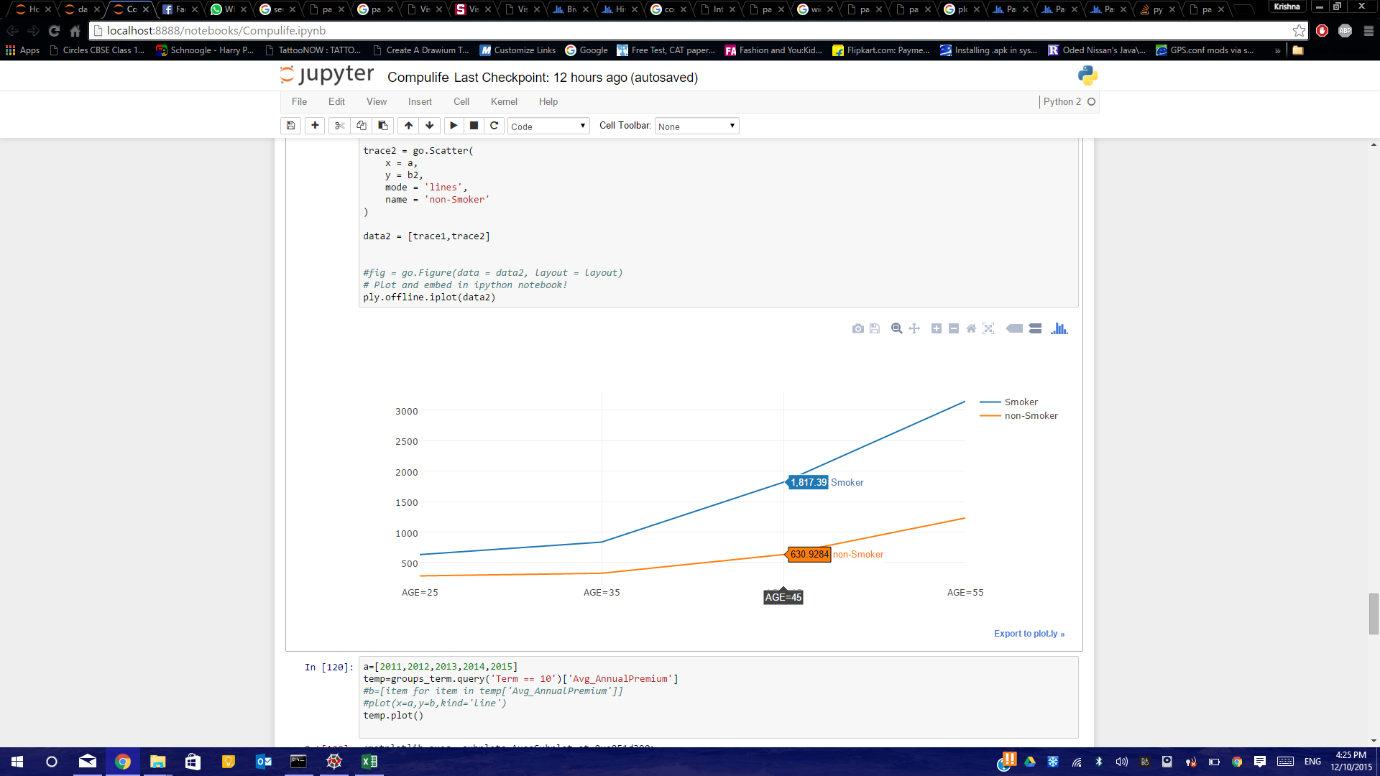
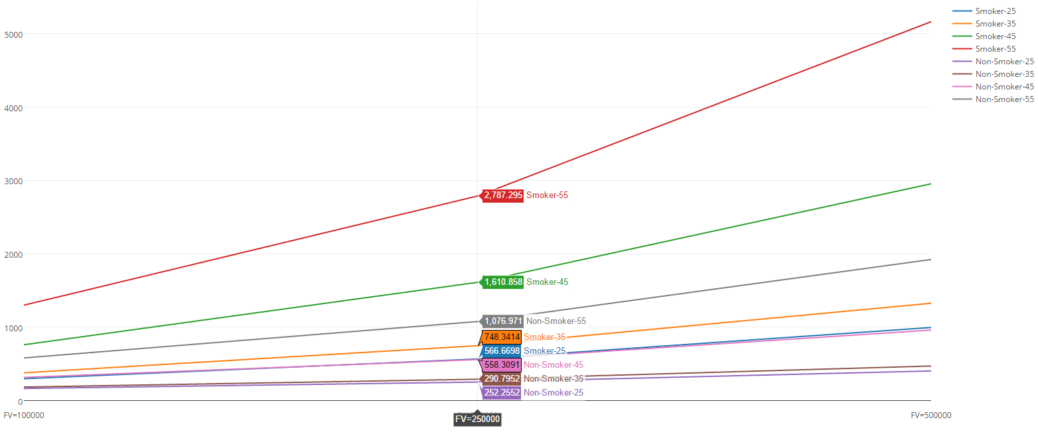
Average Annual Premiums
Based on Age, Sex & Smoke Habit
Annual Premiums vs. Age
Annual Premiums vs FaceValues
Parameters:
Face Value
Age
Sex
Term
Years
Months

Slide 9
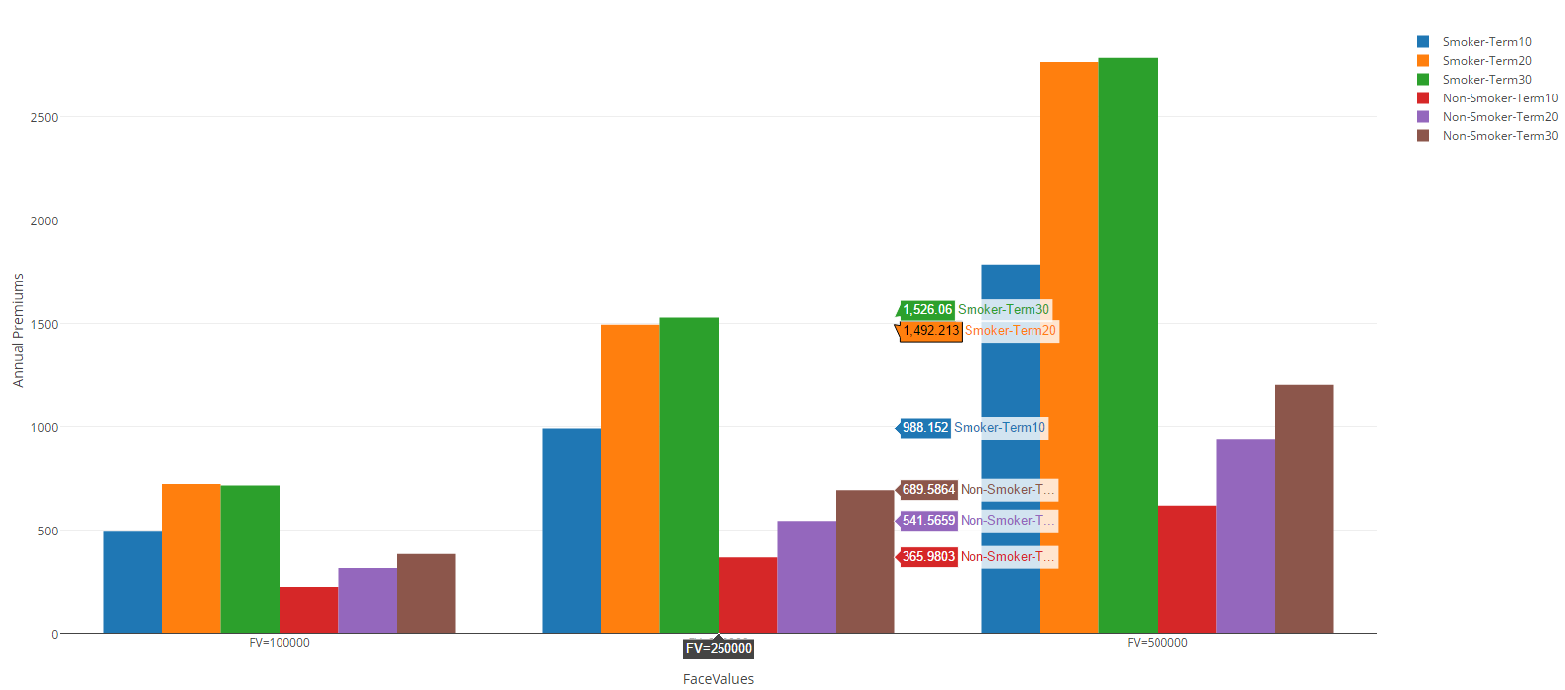
Variance in Annual Premiums for Smokers & Non-Smokers

Slide 10
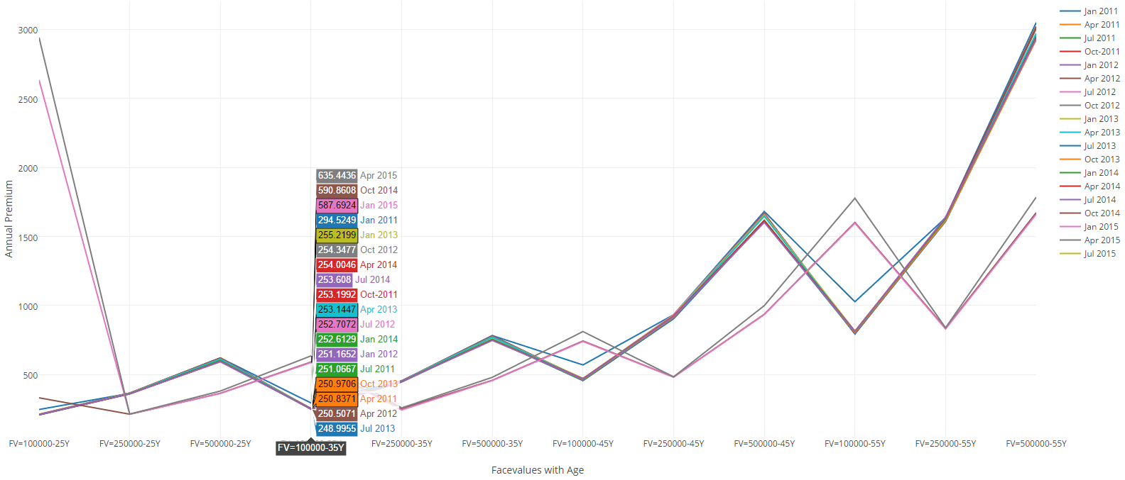
Annual Premiums vs. FaceValue(with Age) for every quarter

Slide 11
Learnings
Pandas data processing - enhanced when combined with other packages
Plotly interactive plots are highly flexible

